Slide 1
INTRODUCTION
SANTOSHINI PANDA
Senior Software Engineer
I’m a Senior Data Engineer at Ferguson, with over 8 years of experience in ETL, Data Engineering, and Data Warehousing. My core expertise includes SQL, Azure Data Factory, Azure Databricks, PySpark, and building scalable data pipelines to transform data into meaningful business insights.
Career question: “Do I enjoy building pipelines, solving data problems, or turning data into business outcomes?”
Challenge yourself
Progressive Mindset
Master a tool at a time, pick a direction.
Learn the “why” first → practice the “how” → automate the repeatable.

Slide 2
Agenda
01 02 03 04 05 06
Technology / Topic Overview What it is • why it exists • where it fits Basics / Foundation ETL flow • data layers • common terms Core Concepts SQL Server • Blob • ADF • Databricks • GitHub Ferguson Context Illustrative enterprise pipeline — not production design AI Leverage & Best Practices Use AI to learn faster, not to skip fundamentals Hands-on Exercises Build a small end-to-end pipeline

Slide 3
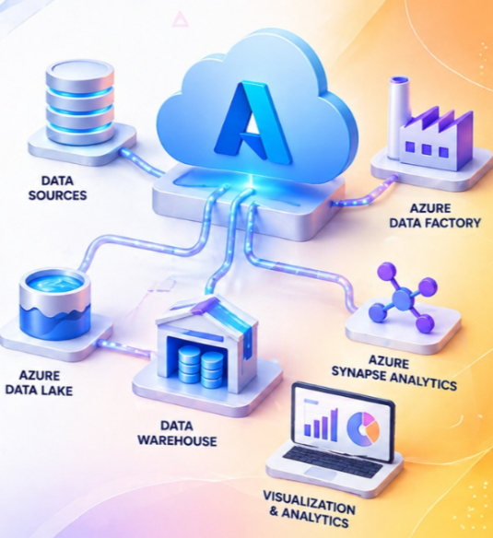
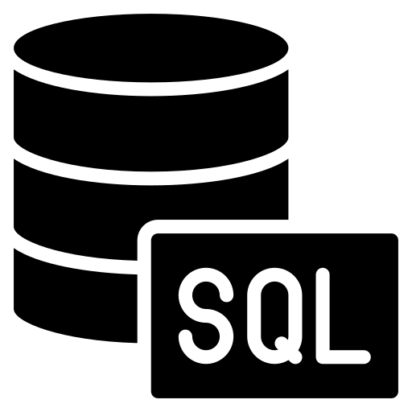


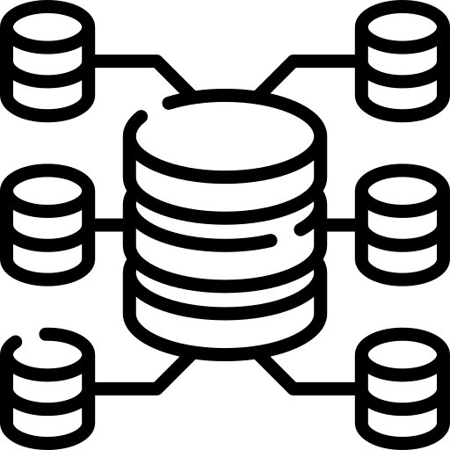
A Freshers’ Roadmap for Data Engineer
Core SQL Mastery
Azure Storage Basics
ADF Pipeline Building
Databricks PySpark Fundamentals

Slide 4
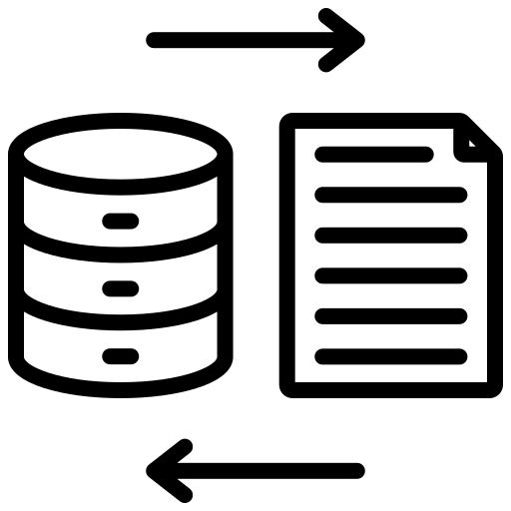

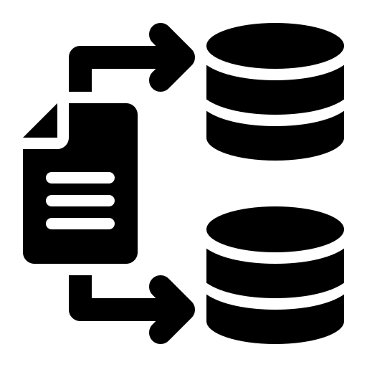
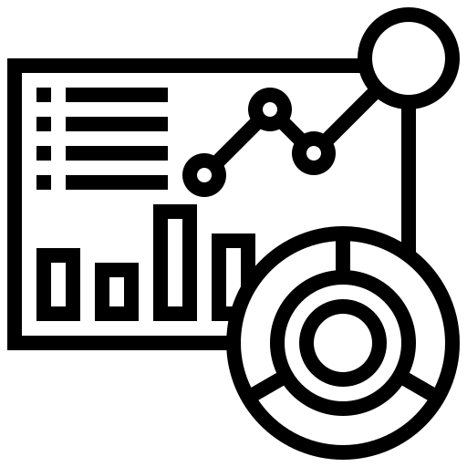
Core ETL Architecture
EXTRACT
TRANSFORM
LOAD
SERVE
Get data from sources
Clean, join, validate, enrich
Store data for analytics/use
Reports, apps, models, decisions
Modern cloud pipelines often use ELT as well: load first, transform in the target platform.
ETL
ELT
Orchestration
Transform before loading
Load first, transform at scale
Decide what runs, when, and in what order

Slide 5
SQL Server — Your Data Foundation
1
2
3
What it is
Why ETL needs it
Freshers should learn
Relational database platform • Tables, views, stored procedures • Keys & relationships • Transactions & security
Common source/target system • Query and filter data • Validate business rules • Create repeatable extracts
SELECT • JOIN • GROUP BY CTEs • window functions Indexes • data types • NULLs
SQL query example
ETL checkpoint
Illustrative
Think like a data engineer
SELECT CustomerId, SUM(Amount) AS Sales FROM Sales WHERE SaleDate >= '2026-01-01' GROUP BY CustomerId;
✓ Row counts ✓ NULL / duplicate checks ✓ Source-to-target reconciliation ✓ Incremental vs full load

Slide 6
Azure Blob Storage — The Landing Zone
1
2
3
Key idea
What it is
Where it fits
Cloud object storage for files / blobs. Think: folders + files, not relational tables.
Raw landing → processed data → curated outputs. Useful for CSV, JSON, Parquet and other files.
Separate storage from compute. Databricks can read/write files without being the permanent storage layer.
Blob container — illustrative snapshot
What to understand
Example folder structure
Not every folder is a database table
raw/ sales/ 2026-08-31.csv curated/ sales/ sales_delta/
Container → path → file/object
Parquet is often preferred for analytics because it is columnar and efficient.
Security is typically handled with Azure identity / access controls.

Slide 7
Azure Data Factory (ADF) — The Orchestrator
1
Trigger
2
Copy / Lookup
3
Databricks
4
Sink
5
Monitor
When should it run?
Move or inspect data
Transform at scale
Store output
Observe success/failure
ADF = orchestration. Databricks = compute / transformation. Blob = storage.
ADF pipeline — illustrative snapshot
Important ADF concepts
[Trigger] → [Copy Data] → [Notebook / Job] → [Success] → [Notify]
Pipelines • Activities • Datasets • Linked Services Parameters • Triggers • Integration Runtime • Monitoring

Slide 8
Azure Databricks — Transform at Scale
1
2
3
What it is
What you write
Why freshers like it
Lakehouse analytics platform built around Apache Spark. Commonly used for large-scale transformation.
Notebooks / Python / PySpark / SQL Read → transform → write Reusable jobs for production workloads.
Python + SQL + distributed processing. A bridge between software skills and data engineering.
PySpark example
Concepts to learn next
Illustrative
df = spark.read.parquet("/mnt/raw/sales") clean = (df.dropDuplicates(["OrderId"]) .filter("Amount > 0")) clean.write.format("delta").mode("append") .save("/mnt/curated/sales")
• Spark DataFrame
• Partitions
• Transformations vs actions • Delta Lake
• Schema evolution performance basics
• joins

Slide 9
Databricks Jobs & Scheduling
1
2
3
Job
Schedule
Run & Monitor
Bundle notebook / task + compute + parameters
Cron / recurring schedule / event-driven patterns
Retries • logs • duration • success/failure
Two common patterns
Pattern A — Databricks owns the schedule
Pattern B — ADF orchestrates the job
Simple recurring transformation that can run independently.
ADF decides dependencies and calls a Databricks job / notebook as one step.
Tip: avoid putting business orchestration logic inside notebooks when ADF is already the orchestrator.

Slide 10
GitHub — Version Control for Data Engineering
1
2
3
Why GitHub matters
What lives in a repo
Core workflow
History + collaboration + code review. Your pipeline code should be reproducible, not trapped in a laptop.
PySpark / Python SQL scripts ADF pipeline definitions / templates README + tests + config
Clone → branch → commit → pull request → review → merge
GitHub — illustrative snapshot
How it connects
Repository view
etl-project/ ├─ databricks/ │ └─ sales_transform.py ├─ sql/ │ └─ checks.sql ├─ adf/ │ └─ pipeline.json └─ README.md
GitHub → source control
Databricks Repo / deployment process → code available to jobs
ADF → orchestration / parameters
Blob / SQL Server → data

Slide 11
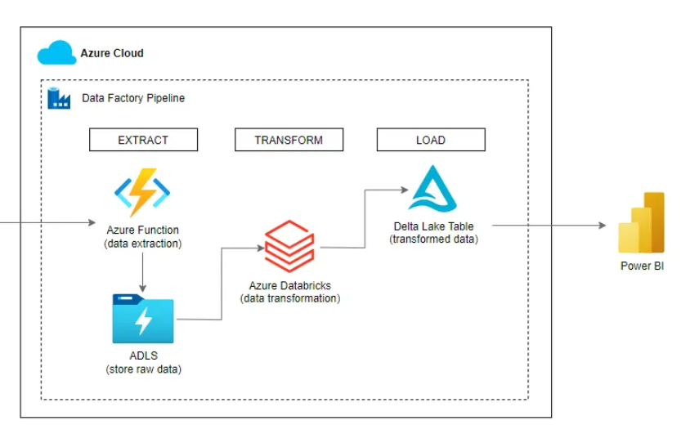
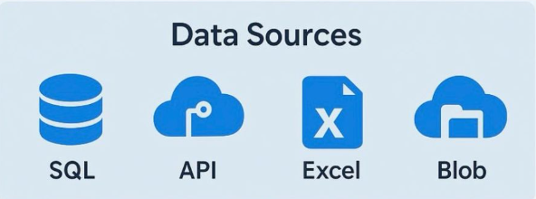
End-to-End ETL Architecture
GitHub sits across the lifecycle: develop → review → deploy → version
Develop
Review
Deploy
Run
Monitor

Slide 12
How ADF + Databricks + GitHub Work Together
1
GitHub
2
Deploy
3
ADF
4
5
Output
Job
Engineer commits PySpark / SQL changes
Approved code reaches the target workspace
Pipeline passes parameters / triggers the workload
Databricks runs transformation on compute
Write curated data + checks
Example parameter flow
Illustrative
ADF parameters → {run_date, source_path, target_path} ↓
Databricks job → notebook/task receives parameters ↓
PySpark → read raw → transform → validate → write curated ↓
ADF → success/failure branch → alert / downstream step
Key lesson: each tool has a job. Good architecture minimizes overlap and hidden dependencies.

Slide 13
Building the Puzzle / Recap / Hands-on Exercises
1
2
3
Exercise 1 — SQL
Exercise 2 — Databricks
Exercise 3 — ADF
Create a sales query: • filter by date • join customer data • aggregate by customer • add a data-quality check
Read a CSV / Parquet file → clean duplicates → add a derived column → write curated output.
Build: Trigger → Copy / Lookup → Databricks → success/failure. Parameterize the date.
Mini challenge: draw the architecture before opening any Azure screen.
✓ Can I explain ETL vs ELT?
✓ Can I write a clean SQL JOIN?
✓ Can I explain Blob vs SQL Server?
✓ Can I tell ADF from Databricks?
✓ Can I explain why Git matters?

Slide 14
Where These Skills Can Take You
1
2
Analytics Engineer
Data Engineer
SQL → ETL → ADF → Databricks / Spark → cloud architecture
SQL → dimensional modeling → dbt / warehouse → BI
3
BI Developer
4
Platform / DevOps
SQL → semantic models → Power BI → business storytelling
Git → CI/CD → IaC → monitoring → cloud operations
Recommendation: build strong SQL + data fundamentals first, then specialize.

Slide 15
Thank you!
Start small. Build one pipeline. Understand every box.
Questions / Discussion
SQL • Azure Blob • ADF • Databricks • GitHub
Santoshini Panda
Santoshini.panda@ferguson.com

